Slide 1
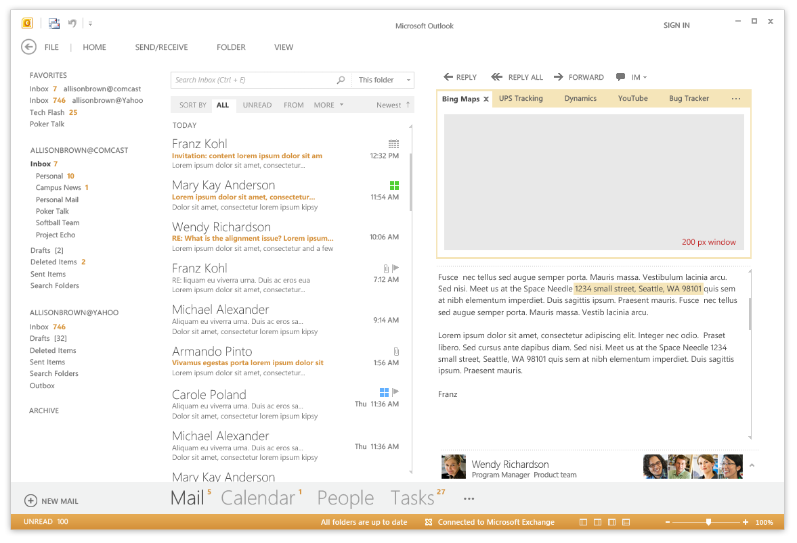
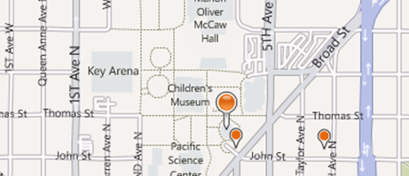
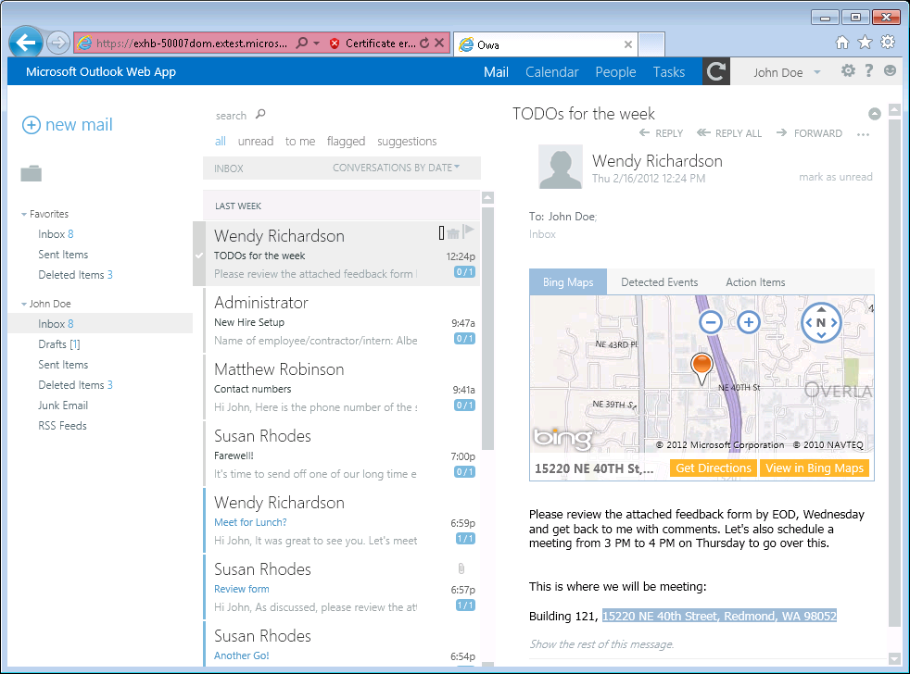
Mail Apps
Write once, run anywhere Outlook runs
Same Mail App runs in Outlook, OWA and Office mobile clients
Development based on activation rules
Activation rules run whenever user selects item
Activated mail apps are added into Outlook UI
Designed to be secure
Mail apps run in an isolated, sandboxed process
Mails apps run with a three-tier permission model
Mail Apps Require Exchange 2013
Notes:
A key concept of mail apps is that they are written once and can run anywhere Outlook runs including the rich client, the browser and mobile devices. The development model for mail apps based on activation rules. The idea is that activation rules for all installed mail apps run whenever user selects item. All mail apps whose activation rules result in activation are then available to use within the context of that selected item. Furthermore, the experience of app activation and starting a mail app is consistent across Outlook and OWA. When a mail app is started by the user, the mail app is designed to provide the user with contextual information for the selected e-mail message, meeting request, or appointment.
The infrastructure for mail apps has been designed to be secure. With Outlook, mail apps are run in an isolated, sandboxed process. In the browser, mail apps are isolated within their own iFrame. As you will see later in this model, mails apps run with a three-tier permission model which affords a great deal of power in a secure manner.

Slide 2

Mail Apps – Up Close and Personal
App Name
Mail App Body
Context trigger
Notes:
This slide shows some key aspects of how mail apps integrate into the Outlook and OWA user interface.
When a mail app has activated for a specific Outlook item, its App Name appears in a special App Bar just above the body of the host mail item. A user can start up a mail app by clicking on the App Name in the App Bar. This action results in the mail app loading which will display the Mail App Body. Many activation rules for mail apps are based on finding specific types of content in the host item. For example, the Bing Maps mail app looks for content inside the body that is interested as an address. Such content is considered a Context Trigger and is highlight in the body of the mail item showing the user what specific data the mail app is using to do its work.

Slide 3
Mail Apps - New Features with SP1
Compose Apps
Office 2013 RTM supported only Read Forms
Office 2013 SP1 supported Compose Forms in addition to Read Forms
Improved access to body and attachment
Accessing attachments no longer requires admin rights
New easy-to-use APIs for accessing attachment name and size

Slide 4
Mail App Hosting
Exchange Server
Hosts mailboxes for users
Host Mail App Manifests
Mail Apps require Exchange 2013
Exchange Server hosts users mailbox
Exchange Server hosts app manifest files
Web server hosts HTML for Mail App
Mail App can make callback to Web server
Mail App can call Exchange Web Services (EWS) EWS calls can be brokered through Web server
EWS
Web Server
Hosts HTML, CSS and JavaScript
Supports CSOM/REST calls from app
Notes:
The infrastructure for mails apps require Exchange 2013 and an Exchange Server which hosts users mailboxes. When a mail app is installed, its manifest must be uploaded into the Exchange App Catalog. However, the implementation for a mail app which includes HTML, CSS and JavaScript is not deployed with Exchange but instead on any standard Web server that can serve up HTML pages.
One powerful aspect of developing mail apps is that they can call Exchange Web Services (EWS) which provides the ability to create new email message and appointments and to read other mail items in the current users inbox. Calls to EWS can be made directly from JavaScript behind the mail app itself. However, the mail app can also call back to its hosting Web server passing the required security credentials so that the Web server can call into EWS. This makes it possible to work with server-side code behind a mail app that does its work in C# and VBNET and still has the power to call into EWS.

